Slide 1


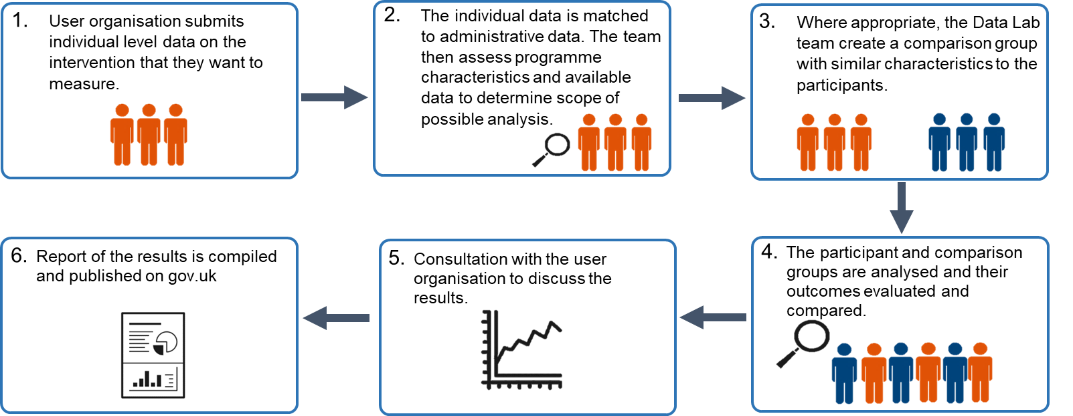
The Employment Data Lab:
Unlocking the power of linked data
www.gov.uk/government/collections/employment-data-lab
employment.datalab@dwp.gov.uk
The problem:
Accessing the data required for these evaluations can be particularly challenging for many organisations, who often face:
Legal restrictions
Varying risk appetites of data holders
Difficulty knowing what is available and where
Security infrastructure requirements
Resource and capability challenges
In the UK there are thousands of organisations that deliver employment support programmes. It is difficult for them to evaluate their work due to a lack of access to data, technical resources and capability. This limits evidence-based decision making around programme development and funding resulting in poorer outcomes.
The solution:
The Employment Data Lab facilitates evaluation using linked data in a way that side-steps many of the barriers associated with sharing large quantities of government data.
Organisation send their data to the department, where the analysis is carried out and aggregate results shared back. No identifiable data leaves the Department. Once the analysis is complete, none of the organisation's data is retained by the Department.
The service has been developed with the support of several stakeholder organisations who continue to participate in our Advisory Board. The model is similar to that used in the Justice Data Lab, produced by the Ministry of Justice.
What does the service produce?
The service estimates the impact of employment programmes using propensity score matching.
The results are compiled into a report and published for all to see.
Plot showing employment rates for participants (solid) and comparators (dotted) before and after an employment programme started. The difference between the lines is the impact of the programme.
Methods
Incoming data is fuzzy matched to DWP data before linking wide ranging administrative data from DWP, HMRC and DfE.
The methodology was designed in collaboration with the Institute for Employment Studies to ensure best-in-class analysis. The methodology has been published and is available on the Data Lab website.
Status and Outlook
The service launched with its first publication in November 2022. The next tranche of evaluations are expected to be published soon.
The service continues to develop. Areas for development include:
Refining the use of existing data sources.
Expanding to new data sources from other government departments.
Developing the analytical techniques and approaches used.

