Slide 1





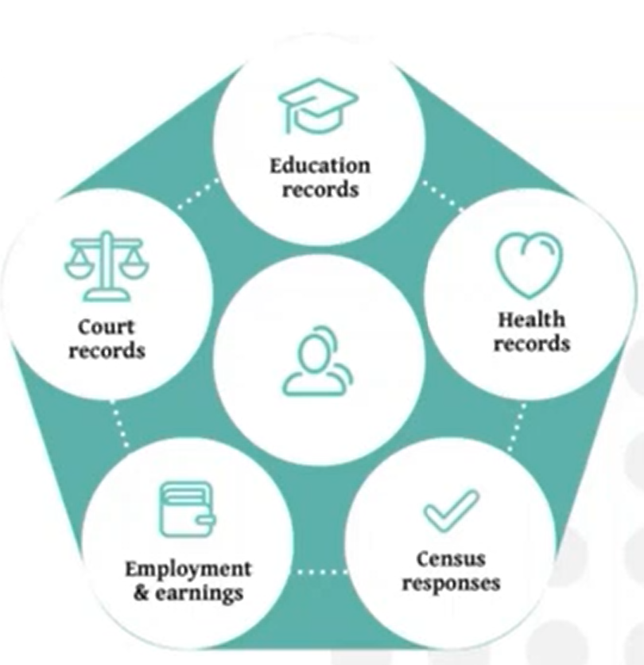
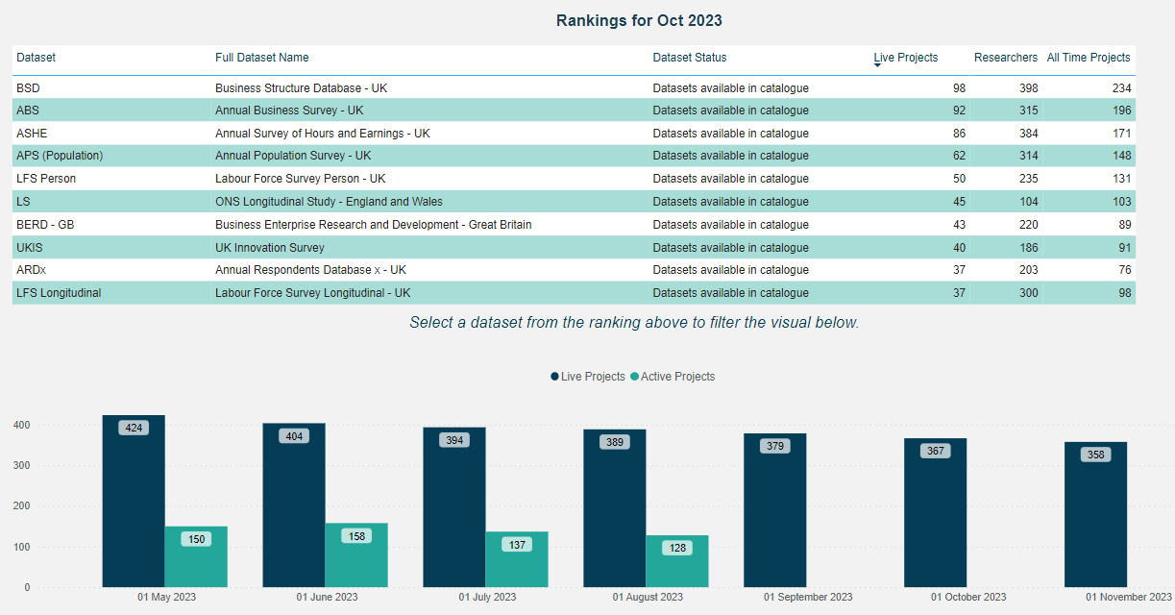
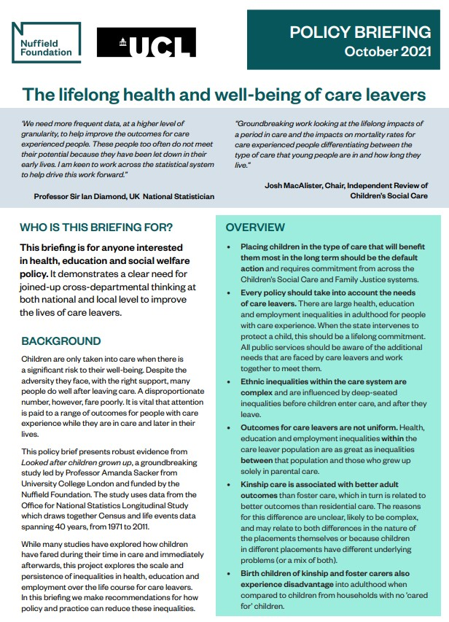

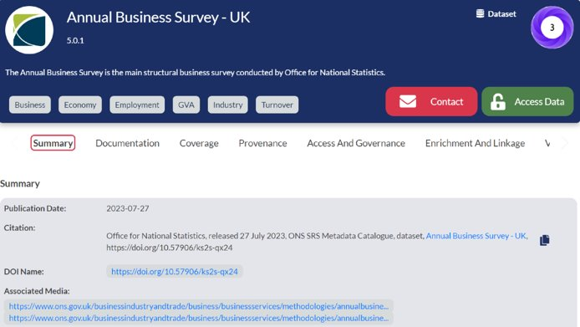
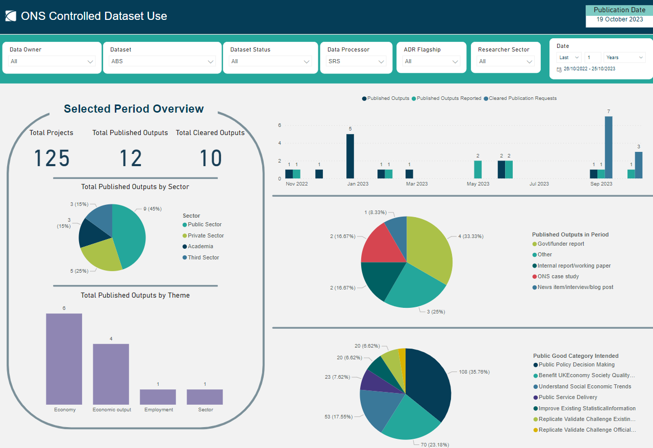
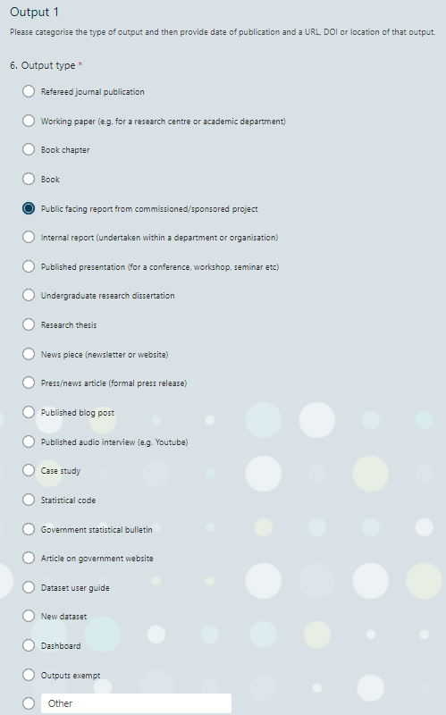


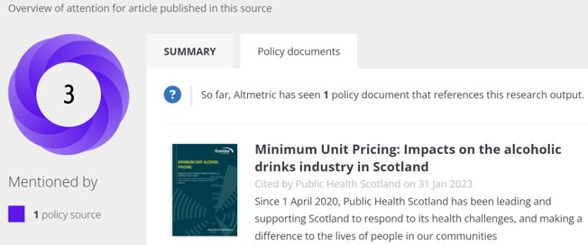
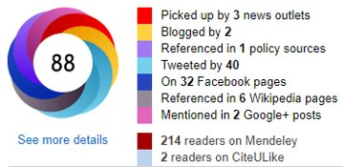


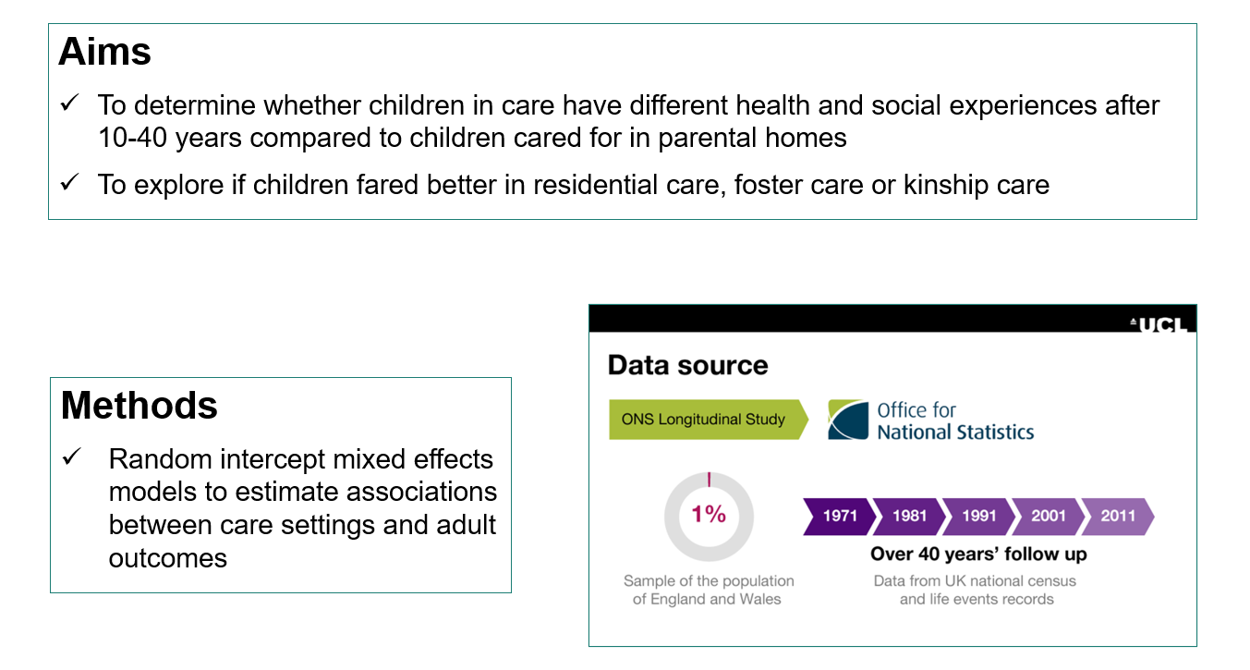

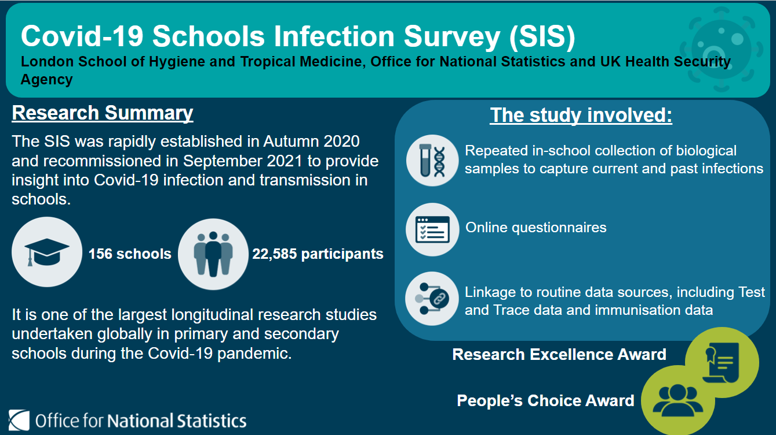
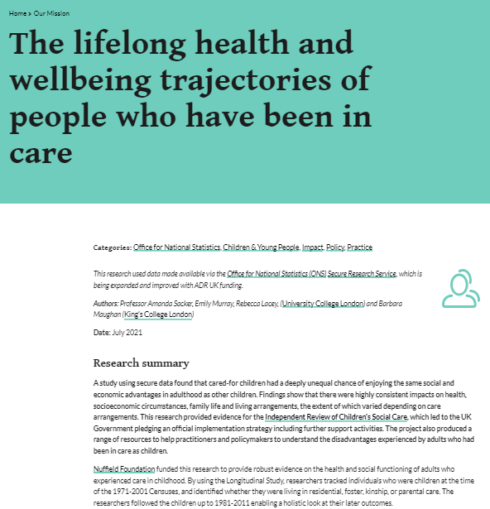
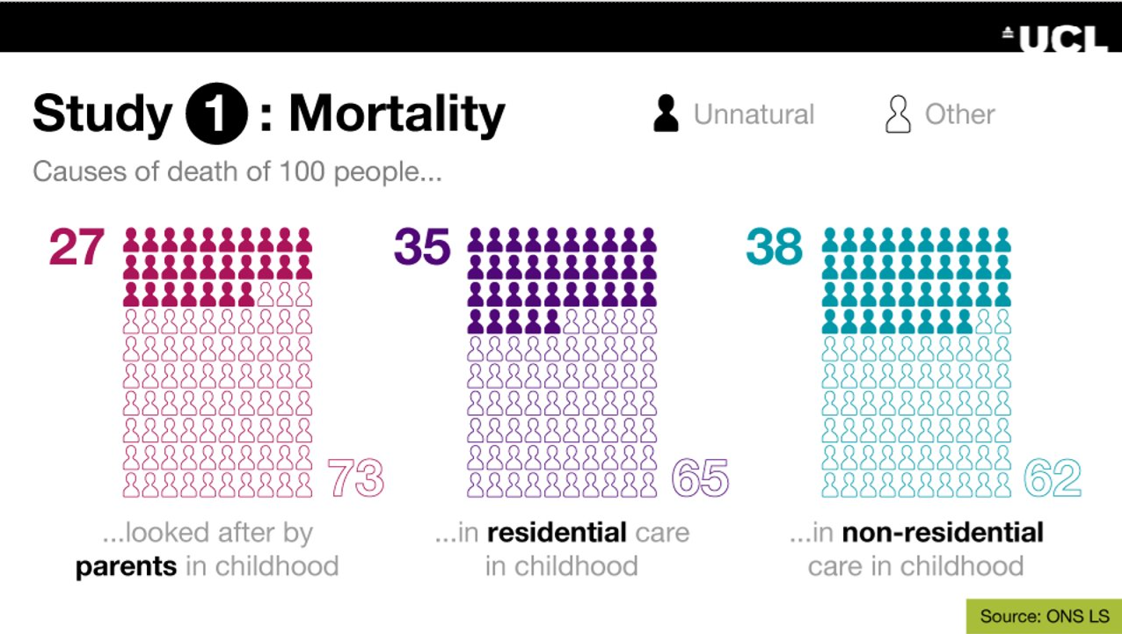
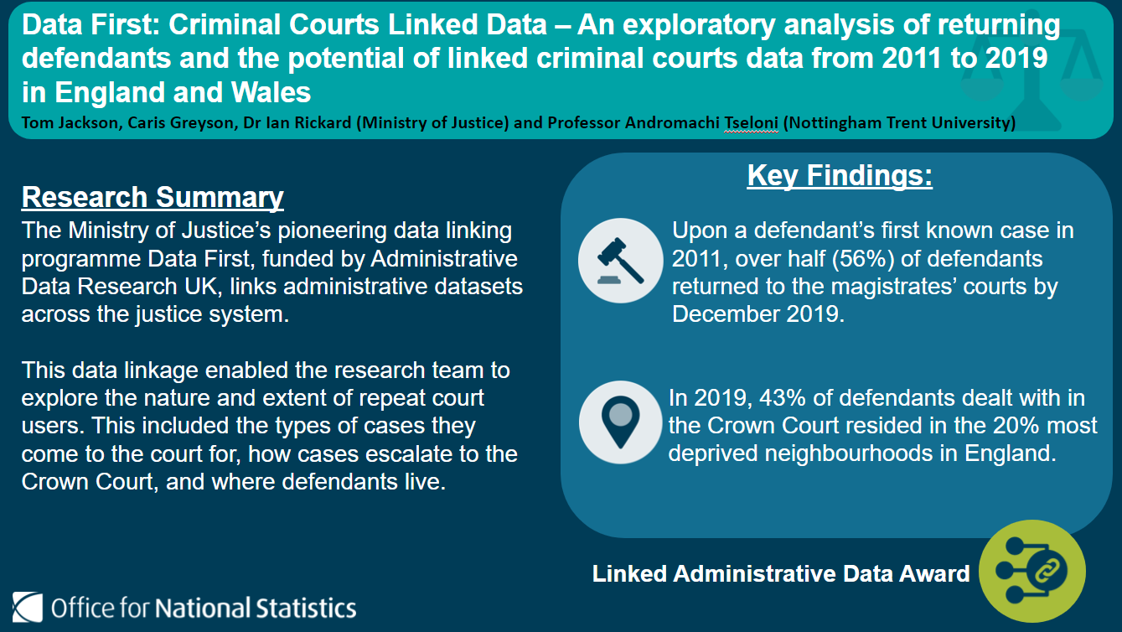
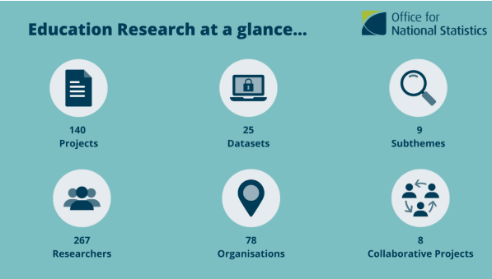
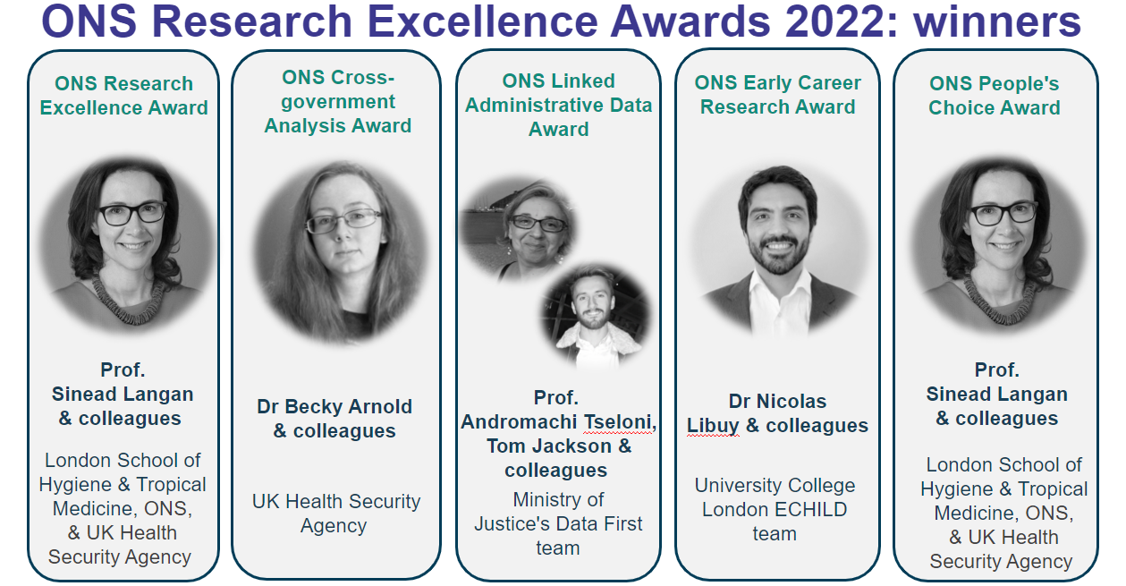


Identifying the golden threads for demonstrating impact
Louise Corti & Alix Taylor-Scopes, Integrated Data Service Strategy Division
Defining impact
Facilitating impact
Engaging for impact
Engagement can be daunting
  You may feel ‘your’ research may not be interesting enough. It is!
Strength in numbers: talk with many people
  Throw a broad net when identifying potential stakeholders
  Think about any potential impact and who might benefit
  Offer to attend/speak at research events
Vary methods of engagement
Consider audiences - from focus groups to public events
Keep the communication channels open
  Set up quarterly meetings for updates and discussions
Impact from:
Research use of secure data
Data service provision: ONS
Secure Research Service
Which data assets?
Impact through:
Volume of data accesses
Innovative data usage
Research outputs
Research outcomes
Communicating impact
Identify potential catalysts for impactful policy outcomes
Build and use your engagement networks
Multi-pronged attacks - don’t be afraid to promote your work
Get your work on to third party sites
Tracking impact
Locating your outputs
Using our DOIs
Dashboarding outputs
Showcasing impact
The golden thread
Promoting research findings
Outcomes: Implications for policy and practice​
In response to the review, the UK Government pledged an official implementation strategy by the end of 2022 ​
Education Secretary promised more support for family hubs that offer early help and intervention​
Funding promised for local authorities to help keep vulnerable children in education ​
Funding for continued delivery of the 'Social Workers in Schools' and designated safeguarding lead supervision programmes​
Range of resources for practitioners and policymakers​
Want to co-write an impact case study with ONS? Get in touch: IDS.Impact@ons.gov.uk

