Slide 1





ADR England Research Community Catalyst - Youth Transitions Workshop
Using the PICO Framework in LEO Studies of Post-16 Learning
Dave Thomson and Peter Urwin
Many thanks to Min Zhang, Emma Gorman, Matt Dickson, Dave Bibby, Sue Maguire, Maria Jose Ventura Alfaro, Andrea Laczik, Dana Dabbous and Olly Newton.

Slide 2
Introduction
Applying the PICO Framework to studies using administrative data
Two examples using the Longitudinal Education Outcomes (LEO) database to study post-16 transitions
  Raising the participation age
  Post-16 education pathways for lower-attaining young people

Slide 3
LEO Database
National Pupil Database: All individuals in state-funded education from 2001/02
  School enrolments
  Attainment (EYFSP, KS1, KS2, KS3, KS4, Post-16)
  Absence (since 2006)
  Exclusions
  Social care (CLA since 2006, CIN since 2009)
  Personal characteristics (free school meals, SEN, ethnicity etc.)
Matched to later education
  Post-16 learning aims
  Further Education (ILR)
  Higher Education (HESA)
And to labour market data
  Employment
  Earnings (including self-employed earnings)
  Benefits

Slide 4
PICO Framework
A framework for formulating a research question, commonly used in health research
P | Population
I (or E) | The treatment being studied. Either the intervention received, or the policy (or event) to which individuals were exposed
C | Who the “treated” group will be compared to (and how)
O | The outcomes being compared

Slide 5
Raising of the Participation Age
The Education and Skills Act 2008 legislated to raise the age of compulsory participation in education or training to the end of the academic year in which young people turn 17 in 2013 and to their 18th birthday in 2015
Includes education and training at school, college or with an independent training provider. Also covers employment, provided some training was provided
Mixed Methods Study, although we only cover the quantitative part today https://www.nuffieldfoundation.org/project/raising-the-participation-age-to-18

Slide 6
PICO: Raising participation age
P | All young people in education in England at age 16
I (or E) | Raising of the participation age to 17 in 2013 and 18 in 2015
C | Between cohort comparison, comparing ‘like-with-like’ pupils pre-and post RPA
O | an indicator for sustained participation in education or training (ET) throughout the first academic year post-16 (Year 12) an indicator for sustained participation in ET throughout the second academic year post-16 (Year 13) indicators for the highest qualification attained by age 18: Level 1 or higher; Level 2 or higher (equivalent to attaining five C/grade 4 or higher GCSEs); Level 3 or higher (equivalent to attaining two A-level passes) indicators for having attained Level 2 or higher in English, and Level 2 or higher in maths Daily earnings at age 20
Notes:
We use a series of linear regression models that aim to isolate the effect of the policy by comparing ‘like-with-like’ students in the cohorts pre- and post-RPA.

Slide 7
Defining the population
We used NPD: Key Stage 4 Pupil Data from 2006 to 2018
Allocate pupils to a cohort based on year_of_birth and month_of_birth
Vast majority appear just once, almost always in the year they turn 16
Deduplication
  NATRES
  SCHRES
  Number of qualifications entered

Slide 8
Advantages of using KS4 data
(Almost) complete coverage of pupils in state-funded education at age 15
  State-funded schools
  State-funded alternative provision
Also includes
  Pupils in independent schools entered for qualifications (NFTYPE in (30,48))
  Some pupils in home education if they enter qualifications (Will be recorded against a state-funded LAESTAB but have SCHRES=0, but not all pupils with SCHRES=0 will be in home education)
  Pupils in secure units taking qualifications (NFTYPE=99)

Slide 9
Not included in the population
Anyone living in England but going to school elsewhere (e.g. Wales, Scotland) at 15
Anyone who has recently moved into England
Anyone in independent schools or home education not entered for any qualifications

Slide 10
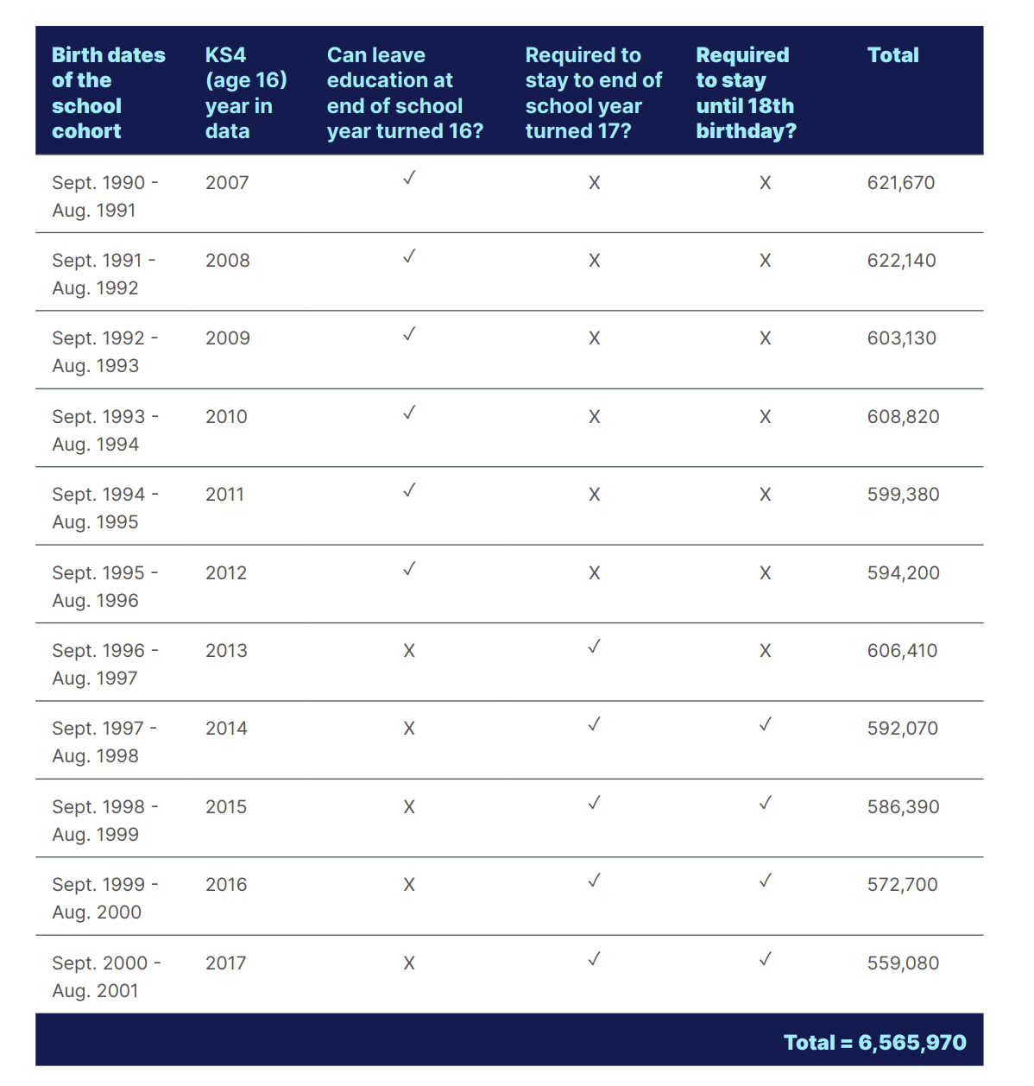
Cohort grid
First affected cohort

Slide 11
LEO Datasets for studying post-16 activities
Education
School Census
ILR
Labour Market
Employment
Benefits
HESA
NCCIS
NEET
Earnings and Self-employment
Notes:
Each of the datasets contributes something- but each has its own quirks and there can be conflicts between them
All of them observe days apart from earnings (annual)
NEET often a residual category (we’ll come back to whether this is a safe assumption later)

Slide 12
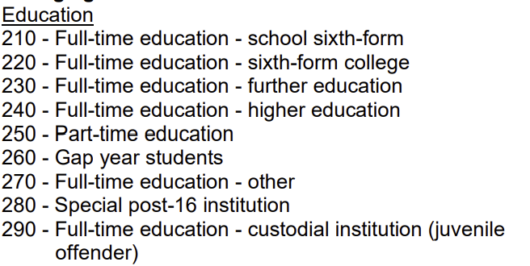
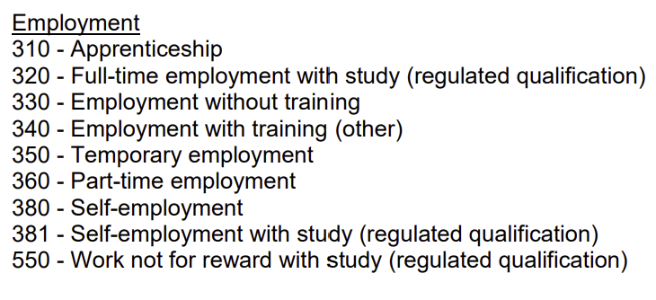
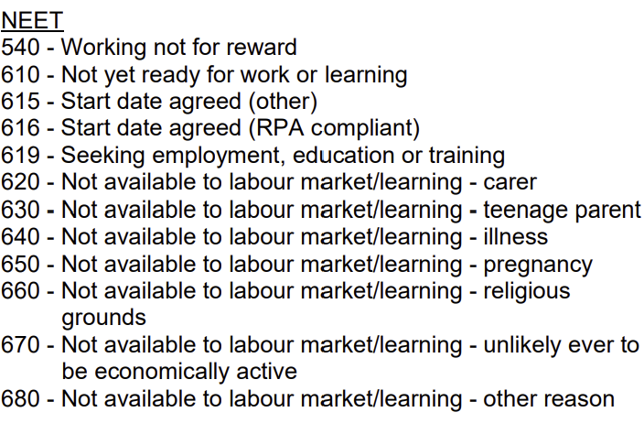
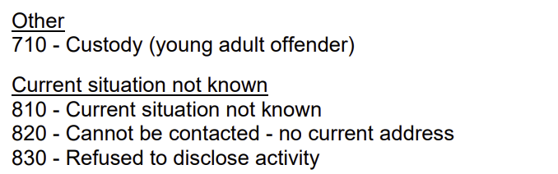
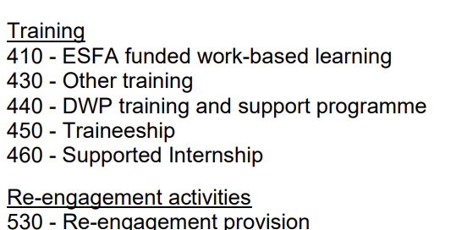
NCCIS monthly activity
Notes:
NCCIS was first introduced in 2010/11
The population coverage has changed over time:
2010-2015: 16-19 year olds (or 16-24 with LDD) resident in each local authority area
2015-2017: 16-19 year olds (or 16-25 with SEND)
2017-2021: 16-17 year olds (or 18-24 with SEND)

Slide 13
Outcomes: Participation
Three enumeration dates each academic year (October, January, May) to coincide with School Census
Assign young people to an activity using the following hierarchy:
Activity | Source
Custody | NCCIS
Enrolled at state school | School Census
Enrolled at FE provider | ILR
Enrolled at HE provider | HE
In employment | Employment
NEET | Benefits/ NCCIS
Other NCCIS activity not above | NCCIS
Not known
Notes:
We use sustained activity: i.e. same activity in all three enumeration dates

Slide 14
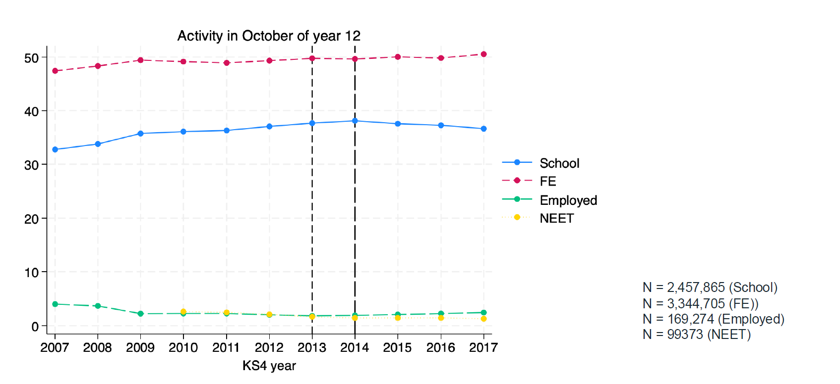
Outcomes: Activity (Oct Y12)
Notes:
We use sustained activity: i.e. same activity in all three enumeration dates

Slide 15
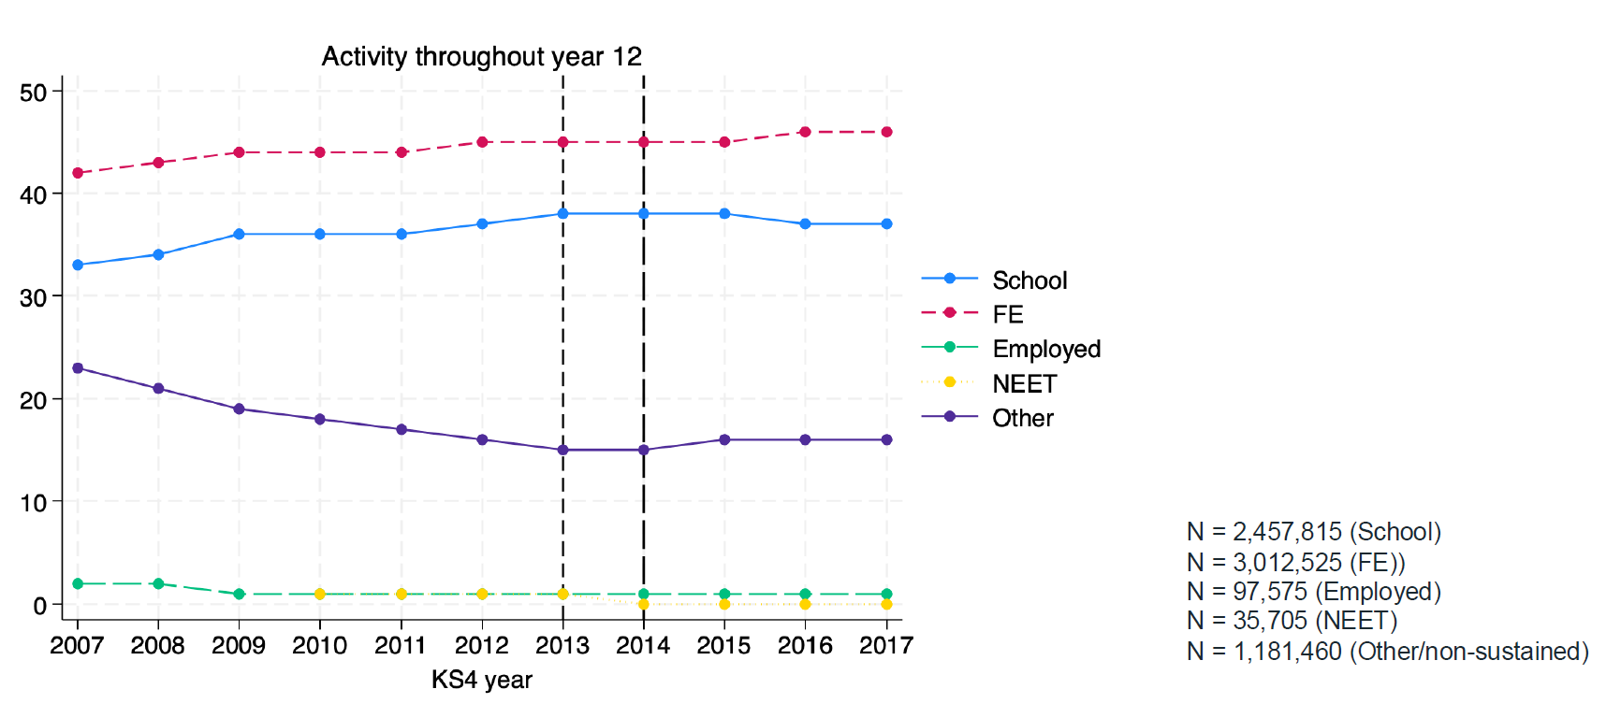
Outcomes: Sustained activity
Notes:
We use sustained activity: i.e. same activity in all three enumeration dates

Slide 16
Outcomes: Attainment
For each academic year:
Level of attainment | Source
Qualification at NQF level 4 or above | HESA/ ILR
Qualifications equivalent to Level 3 | YPMAD
Qualifications equivalent to Level 2 | YPMAD
Qualifications equivalent tt Level 1 | YPMAD
GCSE English grade | YPMAD
GCSE Maths grade | YPMAD

Slide 17
The problem of comparing cohorts
First cohort for which NCCIS is available
First RPA affected cohort
First cohort affected by conditions of funding (resit) changes and by Wolf Reforms
First cohort to take 9-1 GCSEs
Notes:
Comparing outcomes at defined ages (i.e. participation at age 17 and 18) while also controlling for between cohort trends means we are unable to simultaneously control for shocks relating to the specific calendar time.

Slide 18
Estimation
Gender
Ethnic background
English as additional language
the percentage of secondary school time eligible for Free School Meals
ever looked after from age 15 onwards
indicator variables for ever special educational needs,
ever special educational needs at secondary;
absence rates at ages 14 and 15
ever permanently excluded
suspended once age 14; suspended once age 15
suspended two or more times age 14 suspended two or more times age 15
prior attainment:
  KS4 standardised score
  KS2 standardised score
  KS1 standardised score
Notes:
in which pi is one of a number of indicators for sustained participation in some form: education/training, school, further education, employment and finally sustained NEEThood throughout the year. RPA17_Dc is a [0,1] indicator for the cohort affected by the initial RPA to 17; RPA18c is a [0,1] indicator for the cohorts affected by the full implementation of RPA to 18
Quadratic function because there was some curvature to the patterns in ourcomes so having something slightly more flexible than a linear control made sense. With estimating the treatment effect from the intercept shift of RPA17 and 18, it can make a big difference to the estimates if the shape of the trend isn’t flexible enough, though at the same time 11 years is not a lot, so more than quadratic seemed too much. I did a look at using a linear or cubic trend but in the end thought quadratic made more sense for the above reasons.
CLA only from age 15 due to left censoring in the data (first collected 2005/06); ditto exclusions and absence

Slide 19
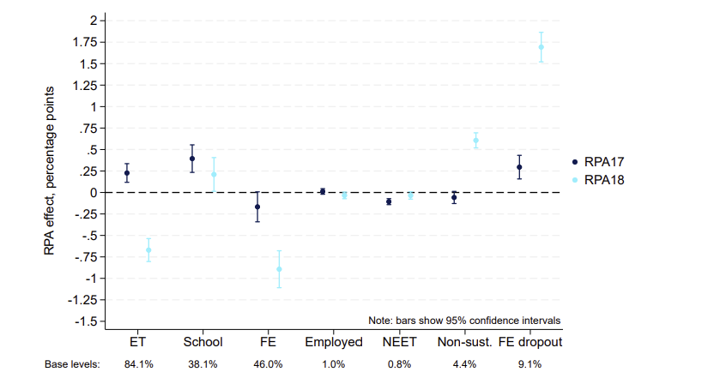
Results: Sustained participation at 16
Notes:
The first two markers show the association between RPA and overall participation in education or training. When the participation age was initially raised to 17, participation increased by 0.2 percentage points (pp), rising from 84.1% immediately prior to the policy’s implementation. As we move along, we can see how sustained participation in school and further education were affected. The 0.2pp increase associated with RPA to 17 is driven by the increase of just under 0.4pp in sustained participation in school from a starting point of 38.1% of young people participating prior to RPA. There is a small and non-statistically significant decrease in sustained further education (FE) participation. The net effect of these changes is the small increase in sustained education and training participation in Year 12. Employment in Year 12 is unaffected by the RPA to 17, but the proportion of the cohort who are NEET throughout Year 12 falls slightly. The proportion who begin participating in October but then drop out before the end of the academic year, i.e. non-sustained activity, does not change significantly.
Looking at the light blue markers, which show the effect of RPA among the cohorts required to remain in participation until age 18, we now see that overall sustained participation has fallen compared to the cohorts before RPA. Moving along the figure we can see that this is because while there is an increase in sustained participation in school, this is offset by a larger reduction in the proportion in FE throughout Year 12. The proportion of the cohort who are NEET is unchanged, but we see a large increase in the proportion of the cohort who make a successful transition to continued education (or employment) but dropout before the end of the year. This was 4.4% of the cohort prior to RPA but increases by 0.6pp with the full RPA to 18. Looking into this, we can see that RPA to 18 is associated with a 1.7pp increase in the proportion of those who start a course in FE dropping out. This is a non-trivial effect compared to the 9.1% of FE starters who dropped out before the policy was introduced.

Slide 20
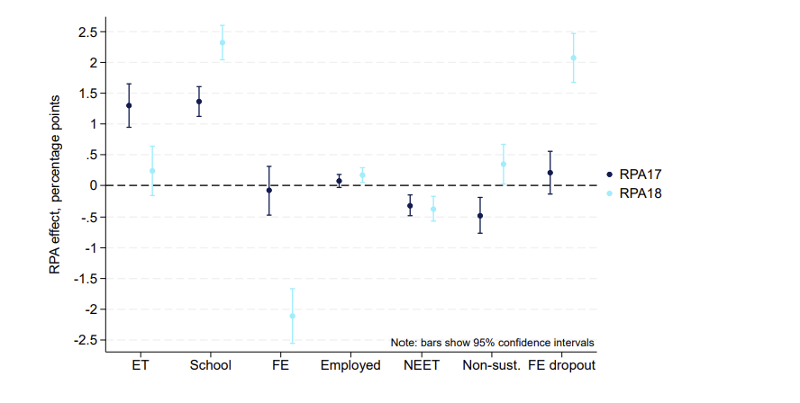
Results: Low attainers at KS4
Notes:
Bottom 25% based on standardized KS4 score

Slide 21
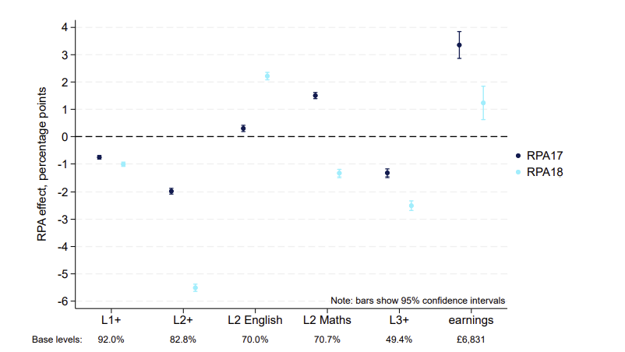
Results: Attainment at 18 and earnings at 20
Notes:
It shows that the likelihood of attaining Level 1 or higher qualifications by age 18 falls approximately 1pp with both RPA to 17 and RPA to 18. The impact on attainment of at least Level 2 qualifications is a larger negative of approximately 2pp for RPA to 17 and then negative 5.5pp for RPA to 18. However, again the latter effect needs to be caveated with the fact that the cohorts affected by RPA to 18 have also been affected by changes to the vocational courses available following the Wolf Review. Some of the reduction in Level 1 and Level 2 attainment will therefore be the effect of a reduced supply of courses at these levels for cohorts completing Year 11 in 2014 onwards. We also see a reduction in attainment of Level 3 or higher qualifications of 1.3pp-2.5pp. For context, prior to RPA approximately 50% of young people attained Level 3 or higher qualifications by age 18.
The reductions in participation and the increase in dropout, particularly in Year 13, associated with RPA are consistent with lower attainment of qualifications at all levels by the end of Year 13. One exception to the reduction in qualification attainment associated with RPA is the positive change in the proportion attaining Level 2 English – equivalent to a grade 4 (formerly a grade C) or higher at GCSE English – that is associated with both RPA to 17 and to 18. Prior to RPA 70.0% of young people have achieved this by 18, but RPA to 17 is associated with a 0.3pp increase and RPA to 18 with a 2.2pp increase in attainment at this level. Similarly, for maths attainment at Level 2, the initial RPA to 17 effect is positive (1.5pp) but for the cohorts affected by RPA to 18, the effect is a 1.3pp reduction in likelihood of having attained this level in maths. Interpretation of these results again requires caution as RPA to 18 coincided with the requirement that young people continue to study English and maths if they had not attained a Level 2 by the end of compulsory schooling. The effect of RPA to 17 can, however, be isolated and it is notable that for both English and maths there is a positive association between RPA and attaining Level 2 or higher in these subjects. The final markers in Figure 4.3 show the impact of RPA on young people’s annual earnings at age 20. For both RPA to 17 and to 18 it shows a positive impact on earnings of 3.4% (RPA to 17) and 1.2% (RPA to 18). This is consistent with the earlier findings that RPA to 17 in particular is associated with increased employment during Year 13 and increased likelihood of attaining Level 2 English and maths, both of which we would expect to positively impact earnings in the early part of the career.

Slide 22
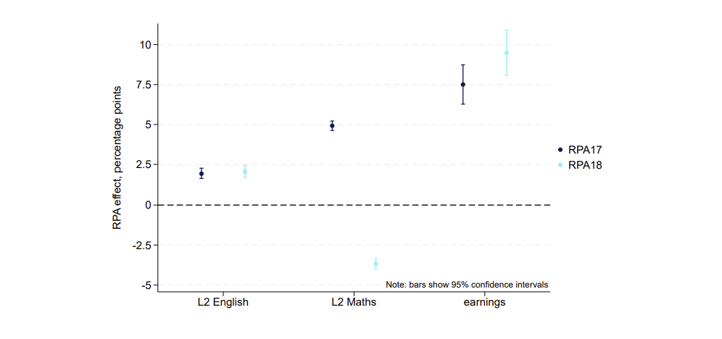
Results: Low attainers

Slide 23
RPA Conclusions
Analysis of administrative data shows that RPA is not associated with large changes:
Year 12: levels of sustained participation initially increased slightly with RPA to 17 but then reduced when the participation age increased to 18; there was a shift away from further education (FE) and into school; there was also an increase in mid-year drop-out from participation, particularly among those in FE.
Overall, the participation picture suggests some improvement in initial engagement but also increased dropout in both Year 12 and Year 13.
Qualifications: there was an increase in the proportion attaining grade 4 or above (grade C or above pre-2017) in GCSE English by 18, and evidence of small improvements in employment and earnings at age 20.
Larger improvements among pupils with low KS4 attainment

Slide 24
Post-16 Pathways: Focus on the ‘C’ of PICO
Example focusing on: Who the “treated” group will be compared to (and How)
Brief intro. to project investigating post-16 pathways for lower attainers – using LEO (similar to RPA data setup).
Counterfactual outcomes (Who?): Overview of treated and comparison group(s) post-16 pathways.
Counterfactual outcomes (How?): Instrumental Variable (IV) approach using distance to post-16 institution, within a young person’s ‘post-16 choice set’.
OLS/2SLS Results, interpretation and possible enhancements to method.

Slide 25
PICO: Post-16 pathways for lower attainers
P | Lower attaining young people (defined by Maths and/or English GCSE attainment at KS4) in 2011 education cohort in England at age 16
I (or E) | General Further Education (GFE) post-16 pathway (mediation analysis)
C | Comparison between pupils in 2011 cohort who take (i) GFE pathway, and those on (ii) alternative post-16 pathways. Using distance as an instrument to emulate random allocation (impacts for ‘compliers’).
O | Indicators of Level 3 or higher (equivalent to attaining two A-level passes) educational attainment by age 19 At least one day in employment in the year aged 24 (and variations) Natural log (Ln) of earnings aged 24
Notes:
Note age 24 is year 2019

Slide 26
Post-16 Pathways for lower attainers
Why? Different post-16 policy response needed for young people facing challenges securing Level 2 [compared to ‘just missing out’ on GCSE].
RDD-type methods used to estimate returns either side of GCSE thresholds (Jerrim, 2021; Machin, McNally and Ruiz-Valenzuela, 2020) - focuses on young people at the margins re: these ‘high stakes exams’.
Challenge: non-random selection into post-16 pathways [potentially related to unobserved factors correlated with outcomes]; no obvious natural experiments or discontinuities.
Challenge: post-16 environment/choices for those who do not meet thresholds is both (i) constrained by institution and (ii) more extensive in terms of options within those institutions [compared to ‘academic’ route].

Slide 27
Post-16 Pathways for lower attainers
2011 Key Stage 4 (KS4) cohort [590,000 pupils] for main analysis, observe post-16 activity up to age 24 in 2019.
Focus analysis on young people who:
Grade 3 (‘D’) or below in Maths and/or English GCSE in year turn 16 (KS4).
Casting ‘wide net’ in terms of young people who do not attain thresholds.
For these 260,000 (46%) pupils in 2011, post-16 options constrained.
Within this group, we focus on young people who achieve grades E, F or G in Maths and English GCSE KS4 (2011).
47,000 (8%) pupils far from thresholds, further constrains post-16 choices.

Slide 28
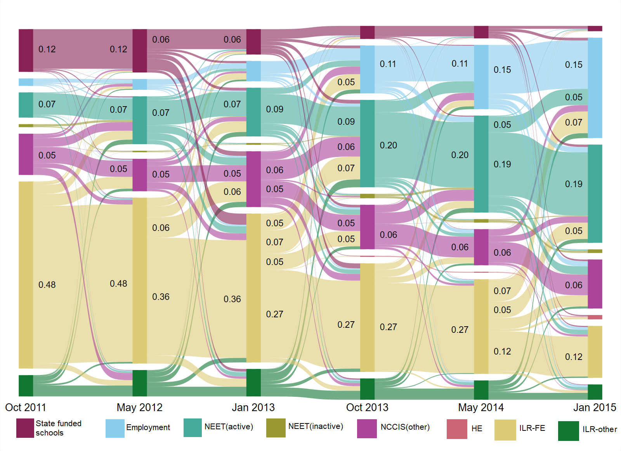
Pupils in KS4 2011 cohort who attained grades E, F or G in Maths and English GCSE: Ever FSM
October of academic year young people turn 17 (Oct 2011 )
State-funded school enrol, predominantly Sixth Form
ILR Other: includes Sixth Form Colleges and WBL providers
NCCIS Other, mostly ‘uncontactable’ young people.
Notes:
Three census points each academic year – Oct, Jan and May. Tried lots of different combinations re: census date(s) capture for this and econometrics [doesn’t change findings].
Either side of diagram are starting and ending %s – description in the middle does best to link without using all census points Thanks to Min!
National Client Caseload Information System (NCCIS) helps provide activity states for young people who are often missing from the administrative data. The hierarchy of assignment to categories adopted for this study has NCCIS NEET Inactive featuring further down this categorisation process, partly explaining the very small numbers in this category.
Detail start and end figures - for this diagram

Slide 29
Counterfactual outcomes (Who?): Treated and comparison group(s) post-16 pathways.
Treated group: those who have initial registration at GFE, those who sustain GFE registration or those who achieve GFE qualification?
Post-16 pathways for lower attainers closer to challenge of Active Labour Market Policy Evaluation (e.g. Cerqua et al., 2020), rather than typical approach in Education Economics.
Comparison group from which we estimate counterfactual outcomes is amalgam/average across other states (Not GFE = zero).
Includes other education (ILR-Other and School), employment and NEET (sustained NEET and fractured education pathways).

Slide 30
Creating post-16 choice sets
For each lower attaining young person we create a Choice Set: includes all post-16 institutions that were a destination for pupils in current and previous 2 cohorts; resident in same MSOA; who also did not achieve Maths and/or English GCSE thresholds.
For each of these choice-set post-16 institutions [General Further Education (GFE); School or College sixth form; Other vocational] created crow-flies distance.
Instrument: distance from a young person’s place of residence, to nearest post-16 ‘training provider’ in choice set (Dorsett et al., 2019; Urwin et al., 2020; Hendrik Matthewes and Ventura, 2022).
Notes:
Mention working on Travel times Data Explained

Slide 31
Distance as instrumental variable (How?)
Instrumental methods utilize a variable that predicts whether in treat or control, that can credibly be argued emulates random assignment.
Imagine poorly-implemented RCT, where rule for random assignment not strictly followed by all administrators (results in ‘fuzzy’ assignment).
The instrument is ‘predictive’ of whether (i) young person is observed in treatment (GFE) or control state; but not (ii) predictive of outcome (e.g. wage/employment probability).
Test for (i) but (ii) can only be argued (supported but not tested).
What is the argument for distance to nearest post-16 institution that is in choice set for lower attainers?
Notes:
Justification for distance to post-16 institutions that enrol these learners (parents don’t make location decisions on this basis BUT……).

Slide 32
Two Stage Least Squares, 2SLS (How?)
Employment_{i} = α + β₁GFE_{i} + β₂x_{1i} + β₃x_{2i} + β₄x_{3i} + β₅Z_{i} …..+ u_{i}
BUT
GFE_{i} = γ + δ₁x_{1i} + δ₂x_{2i} + δ₃x_{3i} + δ₄Z_{i} …..+ v_{i}
Education (GFE) is endogenously determined: it is as a ‘y’ but in equation 1. we treat as an ‘x’.
When you start looking, so much is potentially endogenous, but our focus is on one parameter β₁
2SLS estimates equations 1. and 2. but in order to do this, we need an instrumental variable (Z).

Slide 33
Post-16 Pathways: OLS and 2SLS
Ordinary Least Squares regression, controlling for a rich set of background characteristics, including KS2 and KS3 performance measures, Ethnicity, ever SEN, ever FSM, gender, region of residence; Urban City and Town, Rural Town and Fringe, Rural Village; % FSM in MSOA; household net annual income decile of MSOA, etc.
Varied our approach to definition of the treatment (capturing more than just ‘Oct turn 17’ registration), and also estimated models for an earlier cohort (pupils in 2009 KS4 cohort). Changes do not alter findings.
Distance to nearest GFE in relevant choice set as Instrument (GFE Oct turn 17).
First-stage regression results are supportive of a strong first-stage (F-stat>10).
Notes:
We have also added average GCSE points score at age 16 as a control to see if this changes outcomes and results remain unchanged.
Used alternative indicators such as how many days in employment and whether in continuous employment and findings remain.

Slide 34
Results OLS and IV

Slide 35
Results OLS and IV: Interpretation(s)
IV estimates identify a Local Average Treatment Effect (LATE) that applies to the subpopulation of compliers (Imbens and Angrist, 1994) — i.e. young people whose engagement with post-16 learning is altered by distance to provider.
Only a portion of the variation in the endogenous variable ‘GFE’ (portion matching up with the ‘distance’ instrument) is used to produce slope estimate.
Think of this as capturing the treatment impact associated with the ‘marginal’ learner (i.e. they are on the margins of going to GFE, or not).
This provides us with a Local Average Treatment Effect [LATE] as opposed to the Average Treatment Effect (ATE/ATT) from OLS.

Slide 36
Interpretation (who and how?)
OLS results cover full sample (population), but greater concern that selection into treatment on unobserved characteristics drives findings of positive impact (limits causal inference).
Modelling selection into treatment (on observed characteristics) provides indication of potential direction of bias (e.g. PS Match).
Are we in a DWP (ALMP) or DfE (Education Economics) type context?
Possibly the latter for these OLS results, but IV should capture causal impact for compliers.
Could be that other groups (outside of compliers) experience positive returns, and this is driving OLS results.
Key question: which education or labour market ‘state’ is providing basis for counterfactual estimates in the case of IV and how does this differ to that for OLS estimates?
Notes:
OLS estimates are averaged across the entirety of the relevant population (for instance all those achieving E, F or G grades at KS4). Where we have positive and significant OLS estimates and our IV results become insignificant, it raises the possibility that OLS results are driven by differences in those who are, and those who are not in GFE, that we have not accommodated in the OLS analysis.
However, it could be that other groups (outside of the compliers) do experience positive returns, and this is driving the OLS results.

Slide 37
Interpretation and possible enhancements
Conclude? ‘Results suggest that (at best) there is no significant employment return from post-16 learning for many of the lowest attaining young people (relative to a ‘no-learning’ alternative)’ and [additional mediation analysis] ‘whilst much has changed in education policy in the period since the 2011 KS4 cohort entered post-16 learning, this has not improved outcomes of lower attainers’.
Enhancements:
Expand to create and interpret Marginal Treatment Effects - framework for investigation of how LATE estimates vary across subgroups of the wider sample that underpin OLS results: Dorsett and Stokes, 2021.
Recover margin-specific treatment effects (Mountjoy, 2022).
Notes:
Method that provides a framework for investigation of how LATE estimates vary across subgroups of the wider sample that underpin OLS results (Carneiro, Heckman and Vytlacil, 2011). Use of travel distance as an instrument allows consideration of these Marginal Treatment Effects (Dorsett and Stokes, 2021; Hendrik Matthewes and Ventura, 2022).
There are other potential explanations for these differences. For instance, in Cerqua et al. (2020) we consider the impacts of GFE training for the unemployed (checked using IV) where the control condition is less likely to include those with employment experience that is as valuable as that for a 16-year-old.
Flag our MTE sessions and IV in June

Slide 38
Youth Transitions Resource Hub
https://github.com/Youth-Transitions/resources/wiki
A guide and example scripts to set up LEO to study post-16 activities
Calculates the activity measures used in this presentation

Slide 39
Youth Transitions Resource Hub
https://github.com/Youth-Transitions/resources/wiki
A guide and example scripts to set up LEO to study post-16 activities
Calculates the activity measures used in this presentation

