Slide 1





ADR England Research Community Catalyst - Youth Transitions Workshop
Creating and using proxy measures of socioeconomic background in LEO
Dave Thomson and Peter Urwin
Many thanks to Min Zhang, Emma Gorman and Dave Bibby

Slide 2
Introduction
Guidance on the creation of Free School Meal (FSM) indicators and Index of Multiple Deprivation (IMD) to measure socioeconomic background in LEO.
Considerations of when to use different measures, drawing on recent debates/research – focus on LEO, but also wider debates/measures.
Insights from recent (EEF commissioned) study using ILR and NPD components of LEO to:
  Describe patterns of educational attainment using IMD and FSM measures,
  Consider the pros and cons of various measures, including combinations.
4. Issues with historical FSM data in LEO.
5. Some thoughts on measuring the disadvantage gap.

Slide 3
LEO Database
National Pupil Database: All individuals in state-funded education from 2001/02
  School enrolments
  Attainment (EYFSP, KS1, KS2, KS3, KS4, Post-16)
  Absence (since 2006)
  Exclusions
  Social care (CLA since 2006, CIN since 2009)
  Personal characteristics (free school meals, SEN, ethnicity etc.)
Matched to later education
  Post-16 learning aims
  Further Education (ILR)
  Higher Education (HESA)
And to labour market data
  Employment
  Earnings (including self-employed earnings)
  Benefits

Slide 4
Free School Meal indicators in LEO (NPD)
We consider approaches that are suitable for cohorts which left school before 2018. From that point, FSM eligibility affected by transitional protections (from the introduction of Universal Credit).
From 2018 FSM eligibility "protected" until pupils left school - pupils can ‘flow onto’ FSM but not ‘flow off’ (unless they leave school). This ends in Summer 2026.
NPD School Census has (almost) complete coverage of pupils in state-funded education in England (State-funded schools and state-funded alternative provision).
If population of interest is state school pupils in England in year turn 16 (KS4), current year FSM eligibility is value of FSMeligible recorded in January School Census in year turn 16.
To create measures that reflect eligibility over multiple years, termly FSM eligibility flags are available from Jan. 2007 and annual flags for years 2002-2006.
Notes:
Dave will go into much more detail on the issue of UC protections

Slide 5
Free School Meal indicators in LEO (NPD)
Census data in LEO is provided as one table per term per year - first step is to merge these files into a single table.
For each pupil in the population of interest, can then calculate the percentage of School Census records in which they are recorded as eligible for free school meals.
Limit the scope of the calculation to years in which they are assumed to be in compulsory schooling (i.e. from Reception to Year 11).

Slide 6
Example
PMR | LAESTAB | YEAR | TERM | NCYear | FSM
CCC666DD77EEE9F9FF | 9992001 | 2009/10 | AUT | R | N
CCC666DD77EEE9F9FF | 9992001 | 2009/10 | SPR | R | N
CCC666DD77EEE9F9FF | 9992001 | 2009/10 | SUM | R | N
CCC666DD77EEE9F9FF | 9992001 | 2010/11 | AUT | 1 | N
CCC666DD77EEE9F9FF | 9992001 | 2010/11 | SPR | 1 | N
CCC666DD77EEE9F9FF | 9992001 | 2010/11 | SUM | 1 | N
CCC666DD77EEE9F9FF | 9992001 | 2011/12 | AUT | 2 | N
CCC666DD77EEE9F9FF | 9992001 | 2011/12 | SPR | 2 | Y
CCC666DD77EEE9F9FF | 9992001 | 2011/12 | SUM | 2 | Y
CCC666DD77EEE9F9FF | 9992001 | 2012/13 | AUT | 3 | Y
CCC666DD77EEE9F9FF | 9992001 | 2012/13 | SPR | 3 | Y
CCC666DD77EEE9F9FF | 9992001 | 2012/13 | SUM | 3 | N

Slide 7
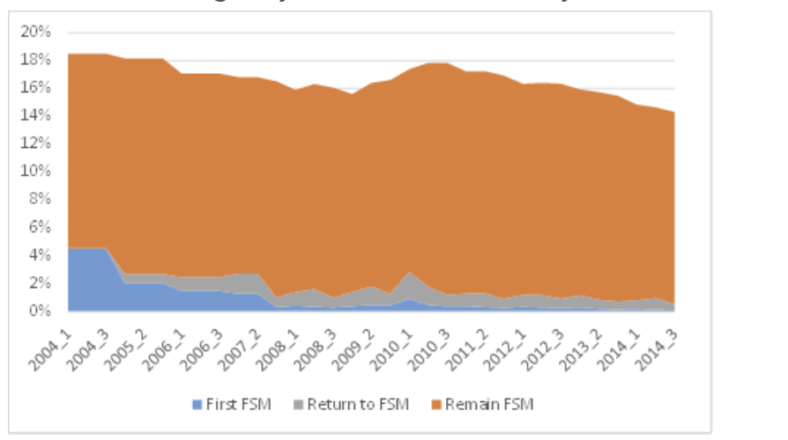
Reception Cohort 2002/03
Track to end of compulsory schooling (age 16)
3 groups of FSM pupils
    1. Those remaining FSM from previous census
    2. Those returning to FSM having not been FSM in immediately preceding census
    3. Those going on to FSM for the first time
https://ffteducationdatalab.org.uk/2015/05/does-the-likelihood-of-experiencing-poverty-change-as-pupils-get-older/

Slide 8
IMD and IDACI in LEO
English Indices of Deprivation (IoD) comprised of 7 indexes, including e.g. Index of Income Deprivation Affecting Children (IDACI) & Income Deprivation Affecting Older People (IDAOPI)
7 IoD25 combined and weighted to create the IMD 2025 (IMD25) – official measure of deprivation in England.
Within LEO, creation of IMD relies on linking data on the Lower Super Output Areas (LSOAs) in which pupils live, to IMD scores for LSOAs available from the ONS data library on SRS.
IDACI is available within School Census without having to link any additional data.
Several iterations of LSOA and IMD over the years
  Two versions of LSOA (2001 and 2011 versions) available in LEO, 2021 version due to be added.
  Versions of IMD have been calculated in 2004, 2007, 2010, 2015 and 2019 (all available in SRS).
  Use extant version for each cohort, e.g. for the 2014 cohort we would use 2010 IMD.
Note that LSOA, FSMeligible and IDACI are considered sensitive data items and must be requested as part of the project application.
Notes:
Remind on average population coverage re: LSOA and MSOA (and OA).

Slide 9
Different measures and their use
Current year FSM eligibility: most straightforward indicator, as simply captures FSM status of a school pupil in the National Pupil Database in the year chosen.
Example: TASO (2024) Equality gaps in earnings and employment by education pathway FSM eligibility at KS4. Focus on education/labour market outcomes for KS4 cohorts 2001-2006.
Ever FSM and Never FSM: 12-year Never FSM indicator would reflect the fact that a young person not recorded as having FSM eligibility in any of the 12 years for which there are data. 12-year Ever FSM - in at least one year the pupil is recorded as having eligibility.
Example: Post-16 pathways to employment for lower attaining pupils: are they working? Nuffield Foundation.

Slide 10
Different measures and their use
IMD: Jerrim (2021), Measuring Disadvantage (focus on informing university admissions).
Uses data from the Millennium Cohort Study to consider how FSM, IMD etc. correlate with long-run family income.
FSM has highest correlation (0.69); IMD has ‘moderate relationship’ (0.47).
Concerns over IMD bias: ‘underestimates probability that BAME children, those living in London, living in rented accommodation, single parent families and those children with young mothers are in the lowest income group’.
IMD changes in methodology from series to series: Key points to note are changes in the indicators used and refreshed LSOA boundaries so change in rank can reflect:
(i) Real change in conditions; (ii) Updated data sources; (iii) Methodological changes; (iv) changes in other areas that shift relative position.
Notes:
Specific measure chosen therefore depends to large extent on specific period being covered, comparisons within/between cohorts, specific research question etc and we have (hopefully!) given some useful guidance.
Note IMD is regional proxy hence not surprising on lower correlation.

Slide 11
Different measures and their use
FSM measures in-between Never and Ever: these reflect persistence of socioeconomic disadvantage throughout a pupil’s school career. E.g. counts of how many years a young person is recorded with FSM eligibility; indicators of whether FSM eligibility is during primary, secondary or both.
Example: Education Endowment Foundation, 2025: Finding the right measure of disadvantage for our 16 – 19 evaluations
Percentage of school career a young person is eligible for FSMs: Some pupils we observe at age 16 were not in the English school system at age 5 - number of terms we observe pupils in School Census during their compulsory schooling varies from 1 to 36.
There are compositional issues with each approach: consider a pupil with only 5 terms of schooling, all of which are FSM eligible and a pupil with 36 terms with 7 FSM eligible.
Dave will cover these issues in more detail.
Notes:
Dave will cover details of the EEF-funded study in much more detail.

Slide 12
EEF - choosing a measure of post-16 disadvantage
DfE uses FSM6 CLA- eligible for free school meals in the last 6 years or ever looked after (or adopted from care)- to measure the disadvantage gap at KS4
Ceases to be calculated at end of Y11
We tested several options for a post-16 measure of disadvantage
  FSM6: eligible for free school meals (FSM) at any point in the six years preceding the end of Key Stage 4. Used for DfE statistics on disadvantage at Key Stage 4.
  FSM6CLA: as FSM6, but additionally includes all students ever “looked after” by local authority or other state care. Used for “pupil premium” funding.
  Ever FSM Year 11: ever eligible for FSM at any point up to the end of Year 11.
  Ever FSM Year 12: as ever FSM Year 11, but also including FSM eligibility in October of Year 12
  IMD27: Resident in one of the 27% most disadvantaged areas in Year 12, based on the indices of multiple deprivation (IMD).
Notes:
More on the disadvantage gap later

Slide 13
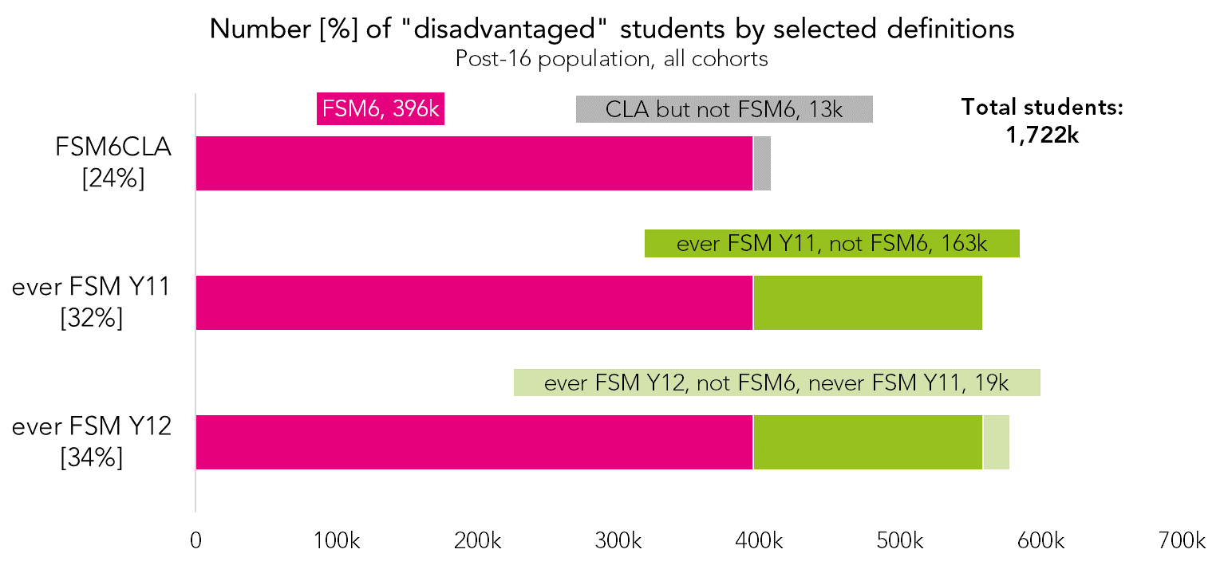
FSM6, FSM6CLA and the ever FSM measures are nested

Slide 14

FSM6, FSM6CLA and the ever FSM measures are nested
Using FSM6CLA rather than FSM6 captures c.1% of post-16 students who were CLA but not FSM6.
But it would introduce a requirement to round numbers to the nearest ten in any outputs.

Slide 15
FSM6, FSM6CLA and the ever FSM measures are nested
Using ever FSM Y11 rather than FSM6 captures c.8% of post-16 students whose FSM eligibility ended during primary school, i.e. a long time before post-16.
But the ever FSM measures are not impacted by eligibility protections, and are therefore more comparable over time

Slide 16
FSM6, FSM6CLA and the ever FSM measures are nested
Using ever FSM Y12 rather than FSM Y11 captures c.2% of post-16 students who became eligible for FSM for the first time in Y12.
We think FSM eligibility is not recorded very reliably in Y12 (see next slide), but any students who are recorded should be included in a post-16 disadvantage measure.

Slide 17
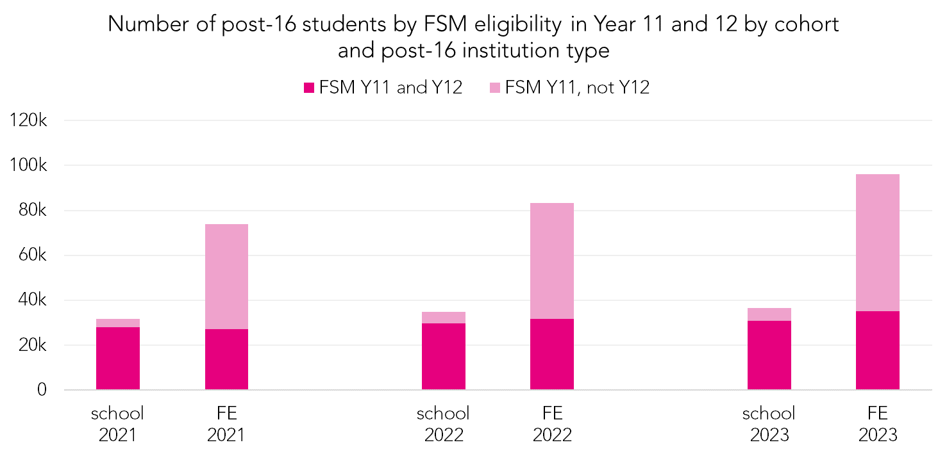
Y11 FSM eligible students are less likely to be recorded as eligible in Y12 if they attend an FE centre than a school
FE students were much more likely than those in schools to be eligible for FSM in Year 11.
They were also much more likely to “lose” their eligibility between Year 11 and 12 (86% of students in schools kept their eligibility vs 37% in FE).

Slide 18
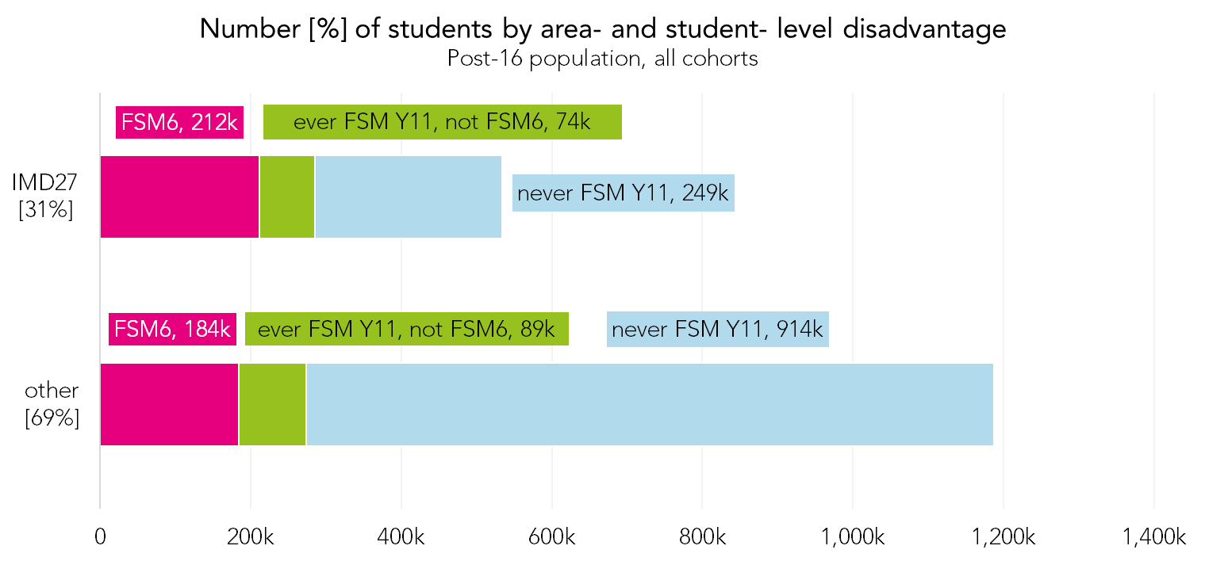
There is some overlap between area- and student- level measures of disadvantage
70% of students are in the same disadvantage category on area- and student- level disadvantage measures.
But only around half of FSM6 or ever FSM students would be considered “disadvantaged” under this area-level measure

Slide 19
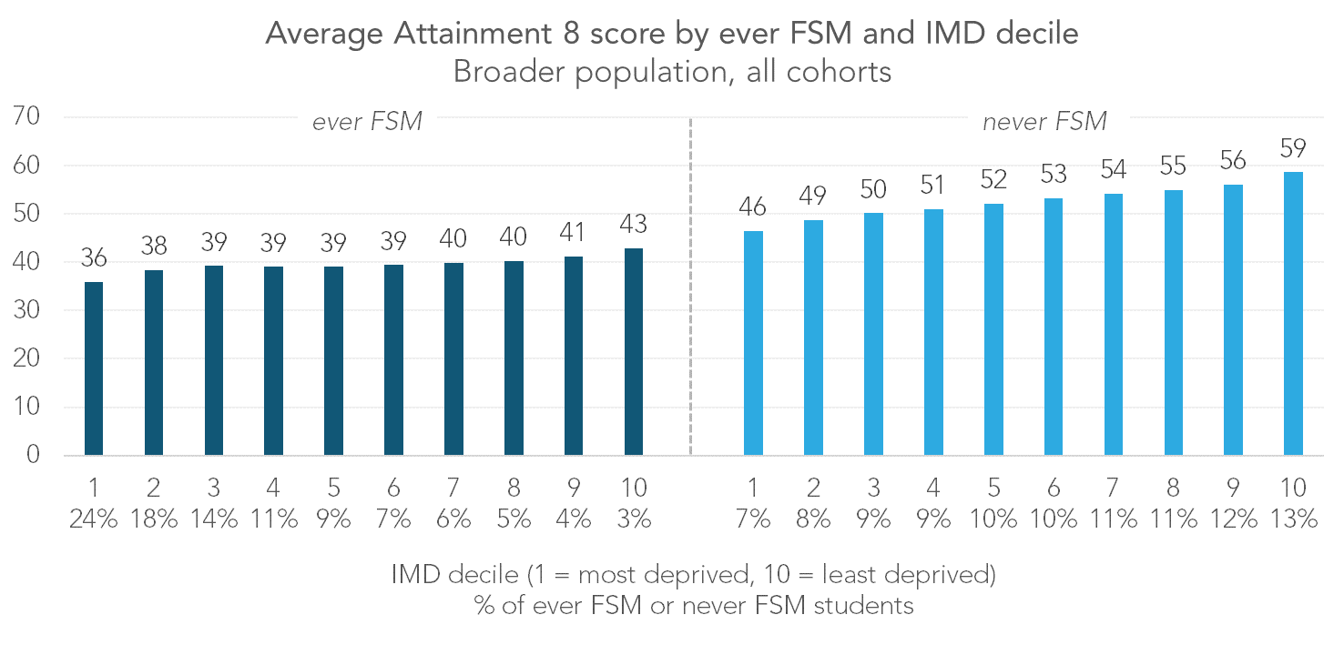
Area-level measures can also be used to differentiate between students in the same individual-level disadvantage grouping
Not all disadvantaged students experience the same severity of disadvantage.
Some non-disadvantaged students may experience some level of disadvantage.
c. 0.7 grades difference
c. 1.2 grades difference
c. 0.3 grades difference

Slide 20
Issues with historic FSM data
Introduction of Universal Infant Free School Meals in 2013/14
Changes to FSM eligibility criteria due to Universal Credit from April 2014
Transitional protections for FSM from April 2018
Universal Primary Free School Meals in London in 2023/24
Extension of FSM to all pupils whose families are eligible for Universal Credit from September 2026

Slide 21
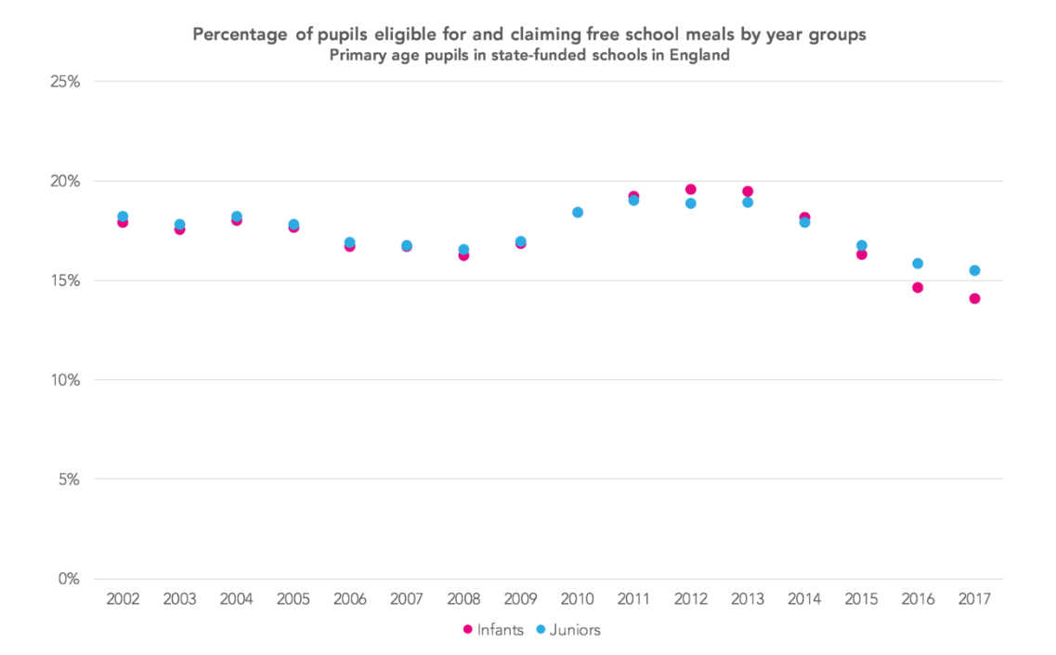
UIFSM
https://ffteducationdatalab.org.uk/2018/12/how-much-pupil-premium-funding-are-primary-schools-missing-out-on/

Slide 22
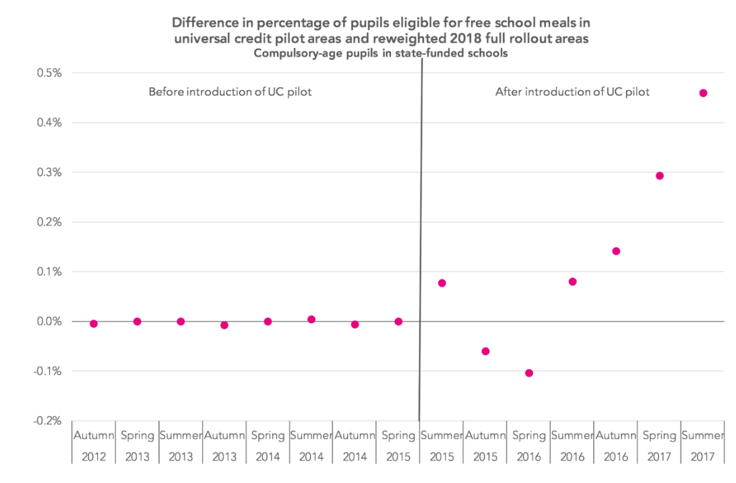
Universal Credit
Gradual roll out to parents with children from Nov 2014
Initially all were eligible for FSM
Compare jobcentres in pilot areas to those where rollout took place in 2018
Uses reweighting to ensure comparability prior to introduction
https://ffteducationdatalab.org.uk/2018/10/the-impact-of-early-rollout-of-universal-credit-on-free-school-meals-eligibility/#footnotes_section

Slide 23
Transitional Protections
From April 2018, FSM eligibility criteria were changed
An income threshold (£7,400) was introduced
Protections were put in place while UC continued to be rolled out
Pupils eligible for FSM in April 2018 would have their eligibility “protected” until March 2022
This was subsequently extended to August 2026

Slide 24
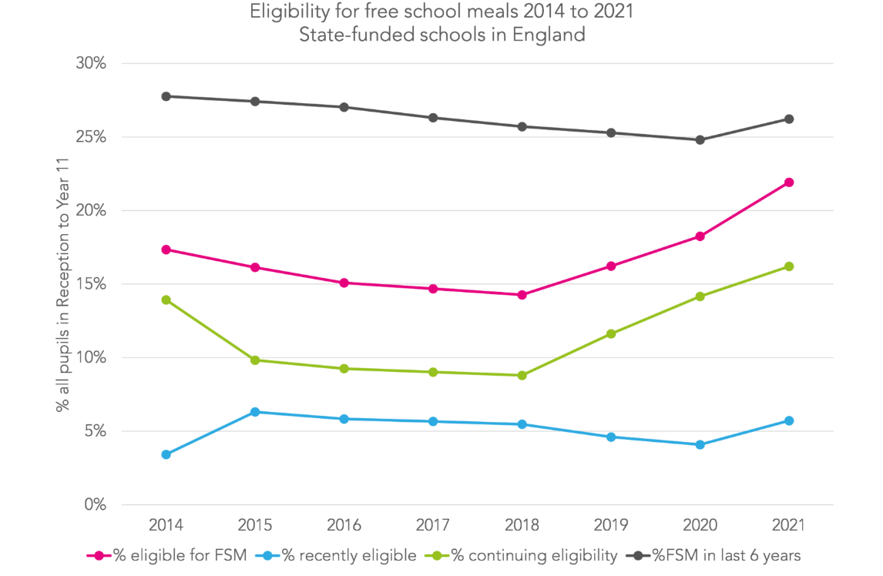
Transitional Protections (2021)
https://ffteducationdatalab.org.uk/2021/10/how-free-school-meal-eligibility-has-been-changing-and-why-we-might-need-new-measures-of-disadvantage/

Slide 25
Impact on long-term disadvantaged group

Slide 26
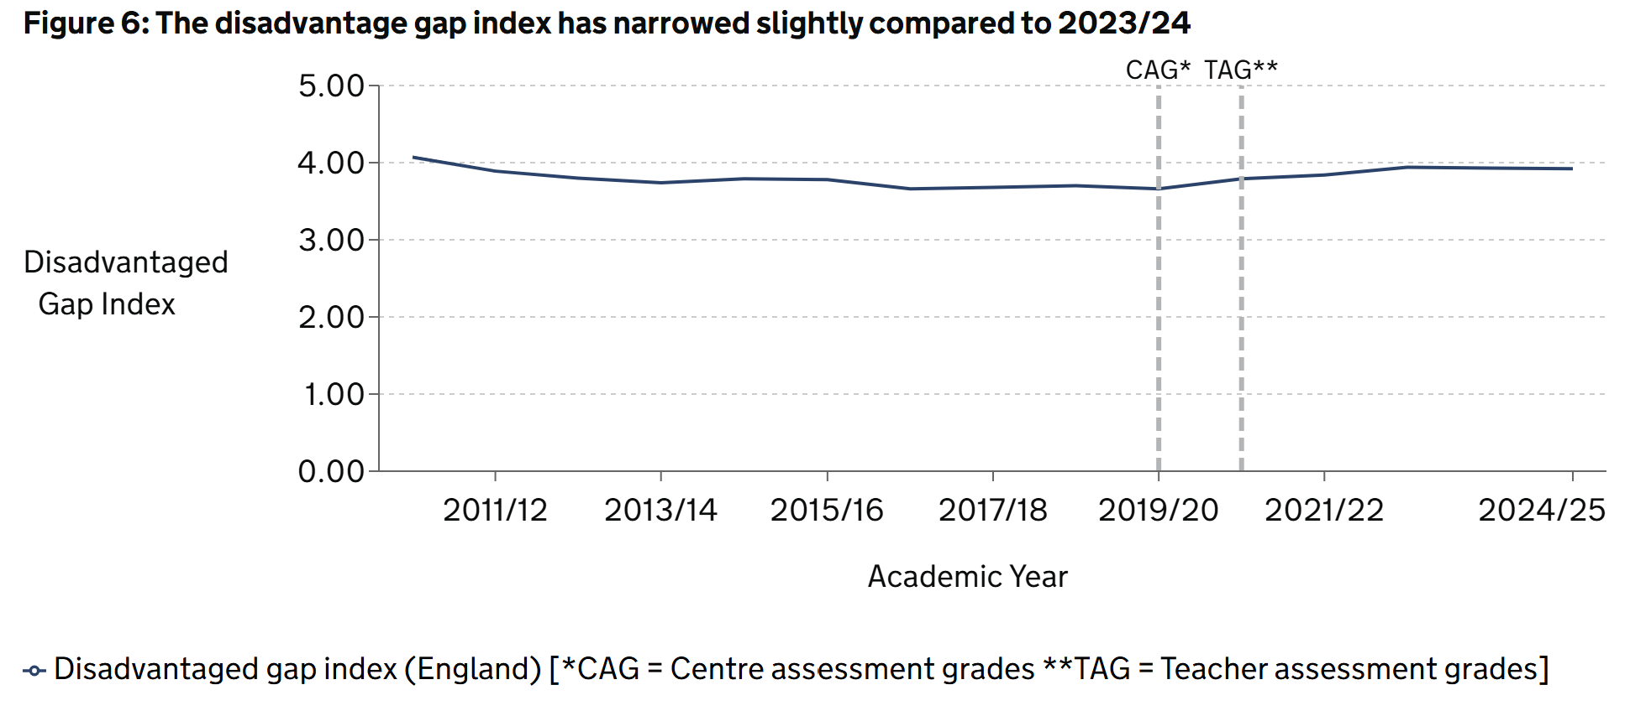
Measuring the disadvantage gap over time
https://explore-education-statistics.service.gov.uk/find-statistics/key-stage-4-performance/2024-25#section-attainment-by-disadvantage-status

Slide 27

Disadvantage Gap Index
Divides pupils at the end of KS4 into two groups:
                Eligible for free school meals in the last 6 years/ CLA (FSM6CLA)
                All other pupils
                Index compares the difference between the mean percentile rank (based on GCSE English and maths score) for both groups
                The difference in ranks is converted into an index using the following formula (the non-disadvantaged mean rank is given a value of 10)
                0 is the minimum possible gap, 10 is the maximum possible gap
Notes:
Use of ranks is helpful as it deals with changes in the way GCSEs were graded in 2017 (switch from A*-G GCSEs to 9-1 GCSEs)

Slide 28
Problems measuring the gap
Anyone eligible for FSM since April 2018 when UC protections were introduced have remained eligible
So, in 2025, the FSM6 group is actually the FSM7 group
And, in 2026, will be the FSM8 group
In 2027, will begin to include newly-eligible pupils (those whose families are in receipt of UC but who are above the £7,400 income threshold)

Slide 29
And yet the Schools White Paper says
[T]he disadvantage gap will be halved. Children from low-income backgrounds will achieve around a full grade higher in each of their GCSEs than is the case today. This equates to over 1.3 million grade improvements across the cohort, and over 30,000 more disadvantaged children passing English and maths at grade 4 or above each year
                https://www.gov.uk/government/publications/every-child-achieving-and-thriving/every-child-achieving-and-thriving-html-version

Slide 30
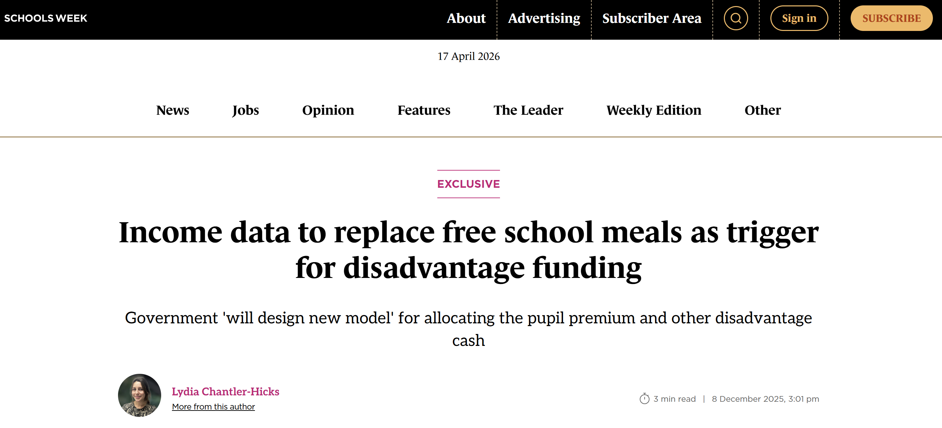
Better data could be on the horizon

Slide 31
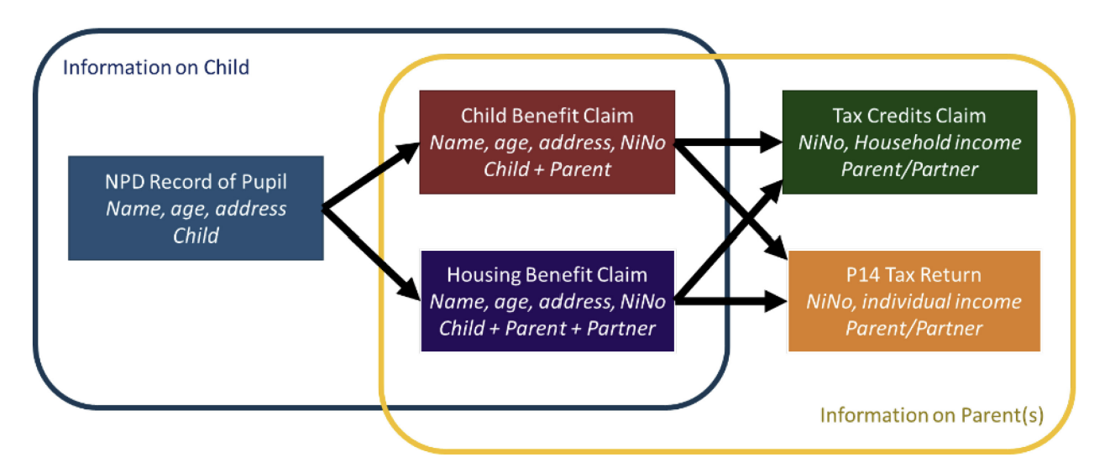
PPMAD
Parent-Pupil Matched Administrative Dataset
Not (yet) available to external researchers
Linked pupils (NPD) to parents’ tax credit and income data

Slide 32
Note on measures outside LEO
Sutton Trust challenged on use of NS-SEC (National Statistics Socio-economic Classification): responded with How we measured disadvantage in our research on the medical profession (Unequal Treatment, 2025).
Drawing on Social Mobility Commission advice to employers. Questions/measures cover:
Parental occupation, which draws on NS-SEC to provide a distribution of SEB groups
Type of school attended (‘economic and cultural advantage’)
FSM eligibility (‘extreme economic disadvantage’)
Highest parental qualification (‘educational advantage’)
Parental occupation is in HESA data, but many of most disadvantaged therefore not covered.

Slide 33
Note on measures outside LEO
Research on intergenerational transfer of social disadvantage using NS-SEC possible with the Office for National Statistics Longitudinal Study (ON-LS).
This allows research into social mobility that does not rely on indicators from school data and allows consideration of spatial (geographic) mobility (where IMD is less useful).
See for instance, Spatial and social mobility in England and Wales: A sub-national analysis of differences and trends over time.
Studying spatial mobility by social background in LEO is challenging, but a Geography Table has recently been added.

Slide 34
Youth Transitions Resource Hub
https://github.com/Youth-Transitions/resources/wiki
A guide and example scripts to set up LEO to study post-16 activities
Calculates the activity measures used in this presentation

